Slide 1
Frequency Response Methods
  Frequency response methods
    Advantages
    Continuous-time systems (review)
    Discrete-time systems
      Position error constants
      Phase lag due to sampling
      Gain and phase margins

Slide 2






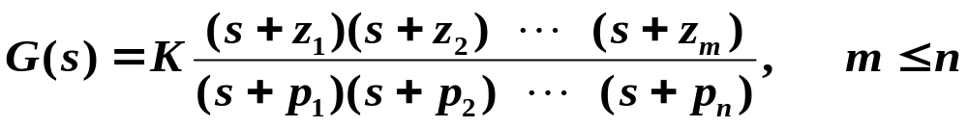
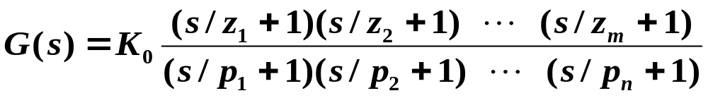
Frequency Response Methods
Im(s)
Σ
Re(s)
Bode plots: using gain margin (GM) and phase margin (PM) to design compensators
Nyquist plots: for stability analysis

Slide 3
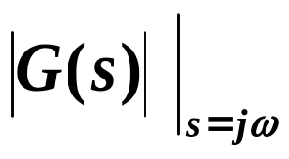
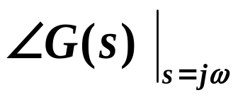
Advantages of Frequency Response Methods
Im(s)
Σ
Re(s)
Sketching Bode gain/phase plots is easy.
Effect of D(s) is easily sketched.
If minimum phase (all poles and zeros in LHP), then by Bode’s gain-phase relationship, only gain plot is needed.

Slide 4

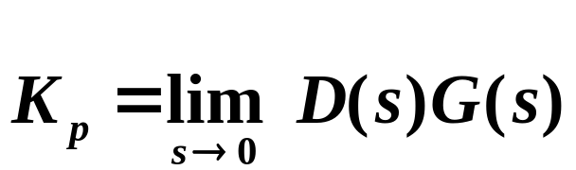
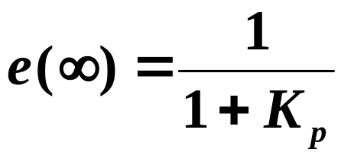
4. Can determine system type.
Σ
|DG|
Steady-state error to unit step:

Slide 5
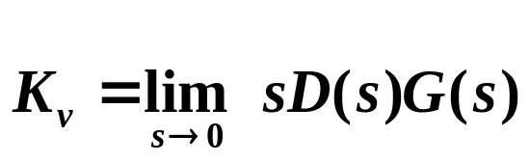
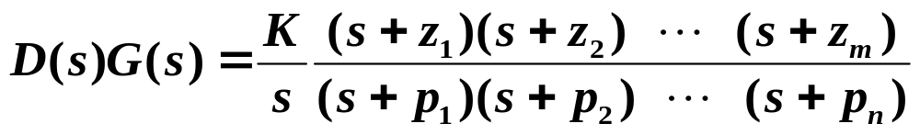
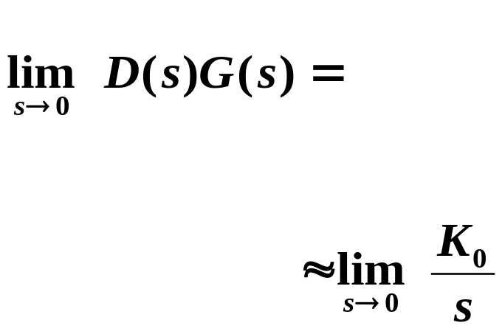
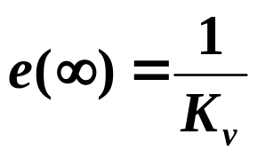
|DG|
Steady-state error to unit ramp:
5. Easy to sketch Nyquist plot and apply stability criterion.

Slide 6




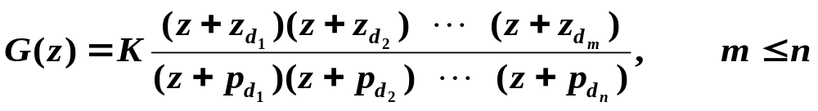
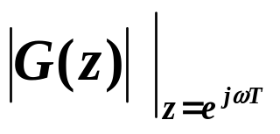
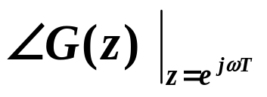
Frequency Response for Discrete Systems
Im(z)
Σ
Re(z)
1
Difficult to sketch by hand.
2. Difficult to see the effect of D(z) on system.
Generally use computers to plot discrete-time frequency response.

Slide 7
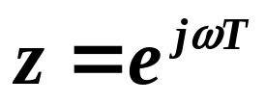

Frequency plots of G(z) are for for
Discuss Example 7.8 of text.

Slide 8
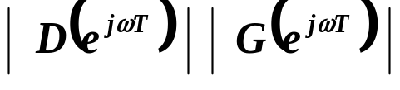
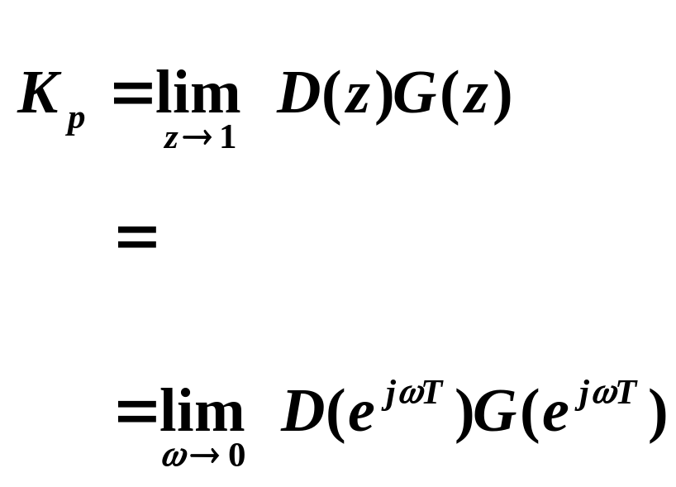
Can still easily determine system type, as well as error constants (K_{p} or K_{v}), from frequency response plots.

Slide 9
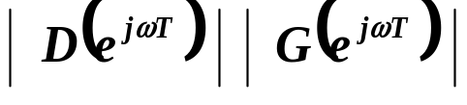
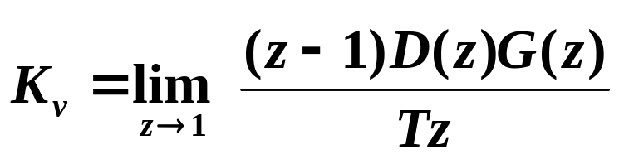
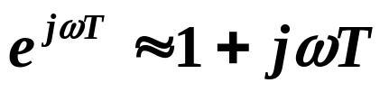

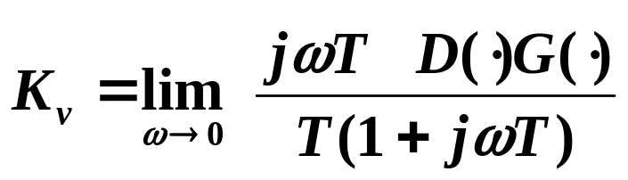
Now,
for
4. Easy to sketch Nyquist plot and apply stability criterion.

Slide 10
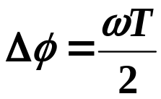
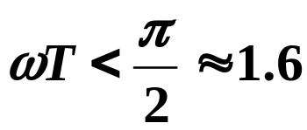
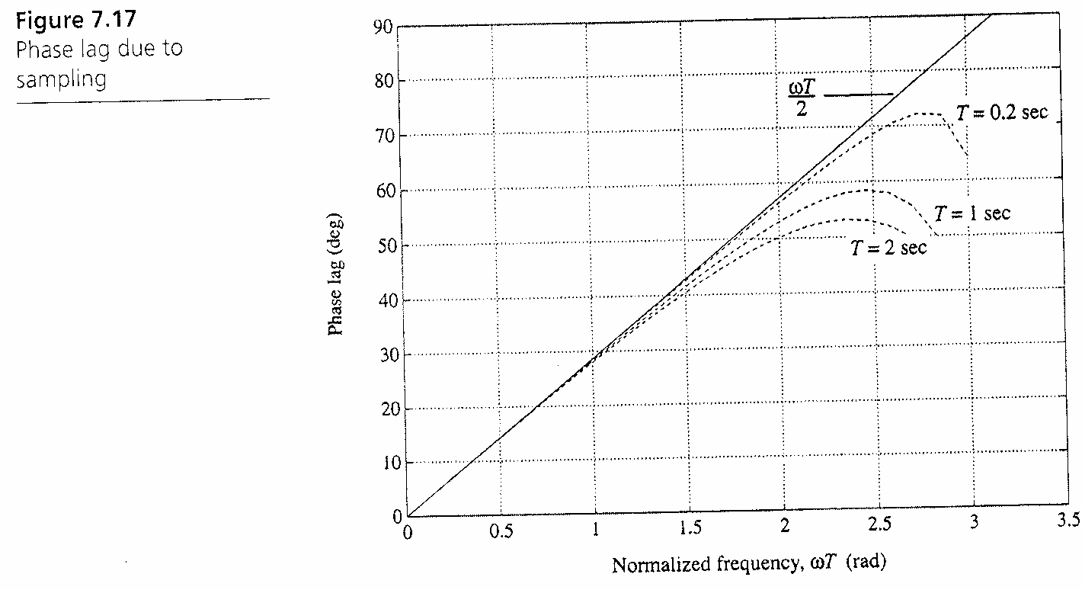

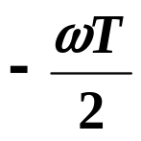

Phase Lag Due to Sampling
Im(z)
good approximation for
Re(z)
1
If have plotted |G(jω)| and (easy to do by hand),
then find PM of G(s).
Then: PM of G(z) PM of G(s)

Slide 11
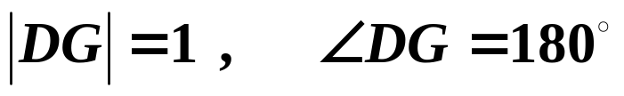


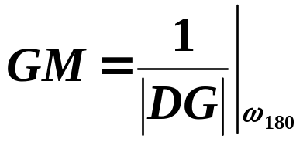
Gain and Phase Margins
Defined exactly the same way for discrete-time systems as for continuous-time systems.
Σ
Critical condition:
GM:
Factor by which can increase open-loop gain before system becomes unstable.
find where on the frequency response plot of the phase.
then read off |DG| at :

Slide 12
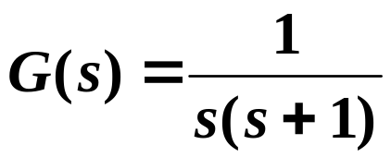




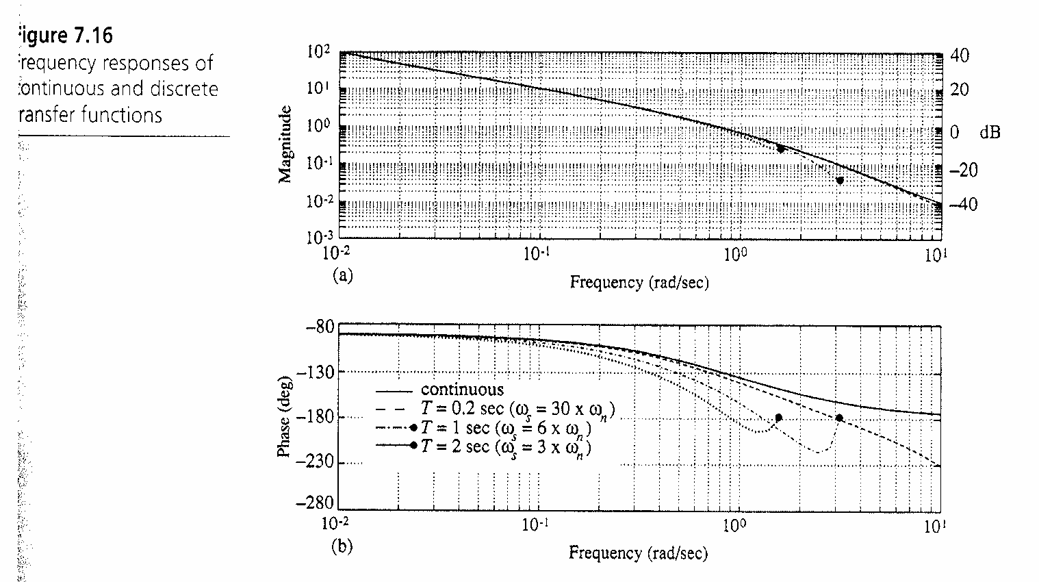

Revisit Example 7.8 of text:
Im(s)
infinite GM
Re(s)
Σ
Figure 7.16
of text.
For G(z) with
T = 0.2 sec:

Slide 13
T = 1 sec:
T = 2 sec:
Figure 7.16
of text.
As T , GM .
If stable,
GM > 1.

Slide 14

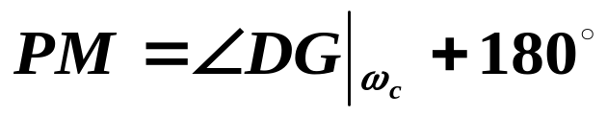
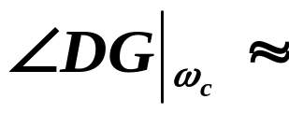

PM:
Find where |DG| = 1.
G(s):
If stable, PM > 0.
PM =
Revisit Example 7.8 of text:
Figure 7.16
of text.
rad/s

Slide 15
G(z):
T = 0.2 sec:
PM =
T = 1 sec:
PM =
T = 2 sec:
PM =
Figure 7.16
of text.
rad/s
As T , PM .
If stable,
PM > 0.

Slide 16

For system to be stable, need PM > 0 & GM > 1.
Rule of thumb: PM > 0 & GM > 1 ➔ stable.
  Works most of the time.
|DG|

